Slide 1
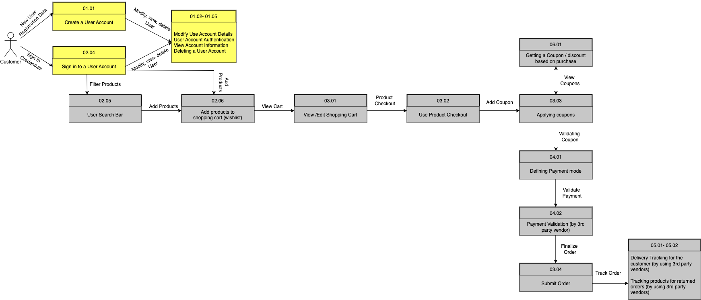
Flaunt
Data Flow Diagram(Logical)

